Slide 1

ВК 3.11 Dental Prosthesis Fabrication Technologies
National Pirogov Memorial Medical University, Vinnytsya
Department of Orthopedic Dentistry
Programme Subject Area: 221 Stomatology
Field of Study: 22 Healthcare
Educational and Professional Program: 221 Dentistry
HIGHER EDUCATION LEVEL: Second (Master’s)

Slide 2
Educational Component Profile
BK 3.11 "Dental Prosthesis Fabrication Technologies"
Specialty: 221 Dentistry
Year of Study: III
Credits: 3.0
Assessment Method: Pass/Fail
Language: Ukrainian, English
Prerequisites: Human Anatomy; Histology, Embryology, and Cytology; Medical Biology; Medical Chemistry; Biological and Bioorganic Chemistry; Medical Physics; Microbiology, Virology, and Immunology (integrates with these disciplines). Propedeutics of Orthopedic Dentistry, Propedeutics of Therapeutic Dentistry, and Propedeutics of Pediatric Therapeutic Dentistry (integrates with these disciplines).

Slide 3
WHY CHOOSE this course
Forms technological thinking and an understanding of the sequence involved in fabricating orthopedic appliances.
Develops the ability to demonstrate clinical and laboratory stages and to operate technical equipment.
Helps justify the choice of structural materials based on the clinical situation.
Teaches how to analyze and prevent common technical errors at various stages of production.
KEY ADVANTAGE:
A combination of technology, materials science, biomechanics, and occlusion for the predictable fabrication of dental prostheses.

Slide 4
What will you study
Fixed and removable prosthetic appliances
Metal alloys, polymers, ceramic materials, and composites
Casting, pressing, and stamping
Ceramic firing, as well as digital modeling and milling
Biomechanics, occlusion, and the fixation and stabilization of prostheses
Articulators, parallelometers, vacuum mixers, and firing furnaces

Slide 5
What will you be able to doupon completing the course?
Determine indications and contraindications for the use of fixed and removable dental prostheses.
Distinguish the fabrication techniques for fixed and removable prostheses.
Demonstrate the clinical and laboratory stages of prosthesis fabrication using phantom models.
Analyze the advantages and disadvantages of fixed and removable prostheses.
Justify the choice of primary and auxiliary materials for the fabrication of various types of dental prostheses.

Slide 6
Final assessment
Forms of study
Lectures
Practical classes
Independent work
Individual independent work
Pass/fail assessment: held during the final practical class, contingent upon successful completion of the course (a total score of 122–200 points across all learning activities) and the absence of outstanding academic obligations.

Slide 7
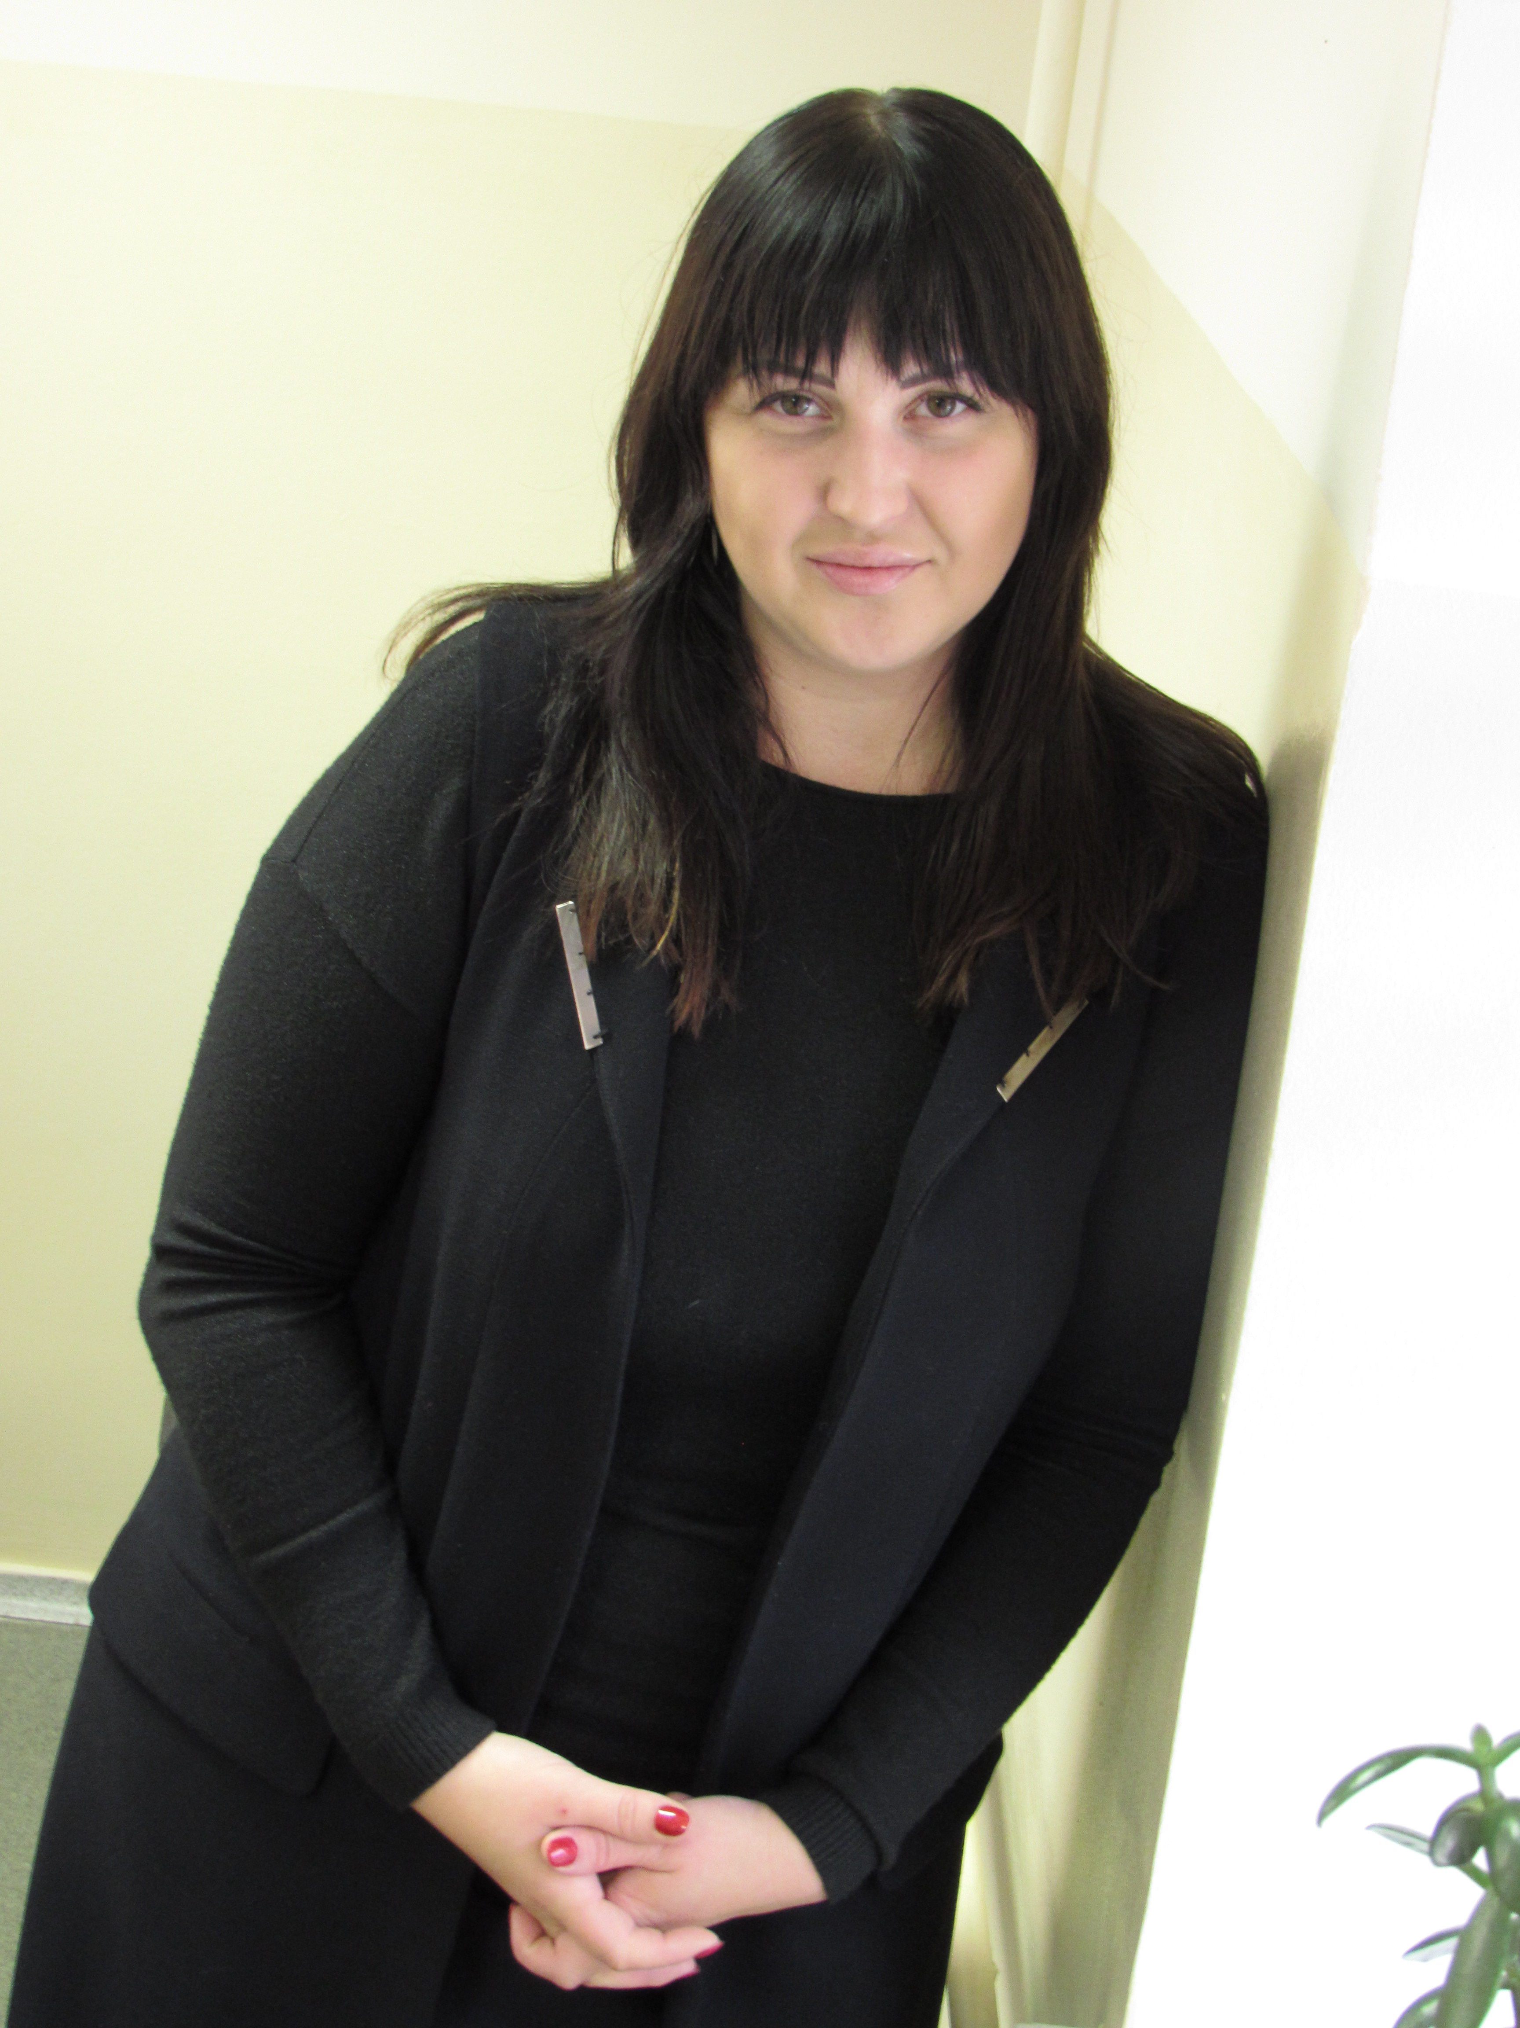
Contact information
COURSE DEVELOPERS
Contact information: Vinnytsia,34 Heroiv Politsii St. (entrance from the university grounds).
Department of Orthopedic Dentistry ort.stom@vnmu.edu.ua
www.vnmu.edu.ua
Alona Hlushak,
associate professor, phd

