Slide 1

ВК 2.13 Clinical and Laboratory Materials Science in Dentistry
National Pirogov Memorial Medical University, Vinnytsya
Department of Orthopedic Dentistry
Programme Subject Area: І1 Stomatology
Field of Study : I Healthcare and Social Welfare
Educational and Professional Program: І1 Dentistry
Higher Education Level: Second (Master’s)

Slide 2
Educational Component Profile
ВК 2.13 Clinical and Laboratory Materials Science in Dentistry
Specialty: I1 Dentistry
Year of Study: 2nd
Credits: 3,0
Assessment Method: Pass/Fail
Language: Ukrainian, English
Prerequisites: Human and Dental Anatomy: knowledge of morphology. Histology: understanding the structure of enamel, dentin, and pulp. Medical Biology, Physics, and Chemistry: knowledge of biocompatibility; basic concepts of strength, elasticity, thermal conductivity, and chemical reactions (oxidation, polymerization). Biological and Bioorganic Chemistry: understanding the chemical composition and polymerization processes of dental materials. Propedeutics of Therapeutic and Orthopedic Dentistry: basic knowledge of tooth structure and the stages of preparation for filling or prosthetics

Slide 3
WHY CHOOSE this course
Shapes a dentist’s "engineering" mindset and a clear understanding of how each material works.
Develops speed of movement when mixing cements, gypsum, and silicones.
Helps learn to communicate with dental technicians using a shared professional language.
Teaches how to properly use laboratory equipment and measuring devices.
Provides a solid foundation for error-free work during the senior years of study.
KEY ADVANTAGE: This marks the transition from theory to the practical mastery of mixing algorithms and the precise observance of procedural protocols for handling dental materials during the pre-clinical stage of training.

Slide 4
What will you study?
Relationship between composition and properties — how material structure influences clinical and laboratory characteristics.
Material requirements — medical-technical criteria and the intended use of various groups of dental materials.
Application technologies — selection guidelines and the role of materials in fabricating prosthetic appliances.
Manual instruments — procedures for using rubber mixing bowls, flexible and metal spatulas, knives, and burners.
Measuring devices — techniques for using micrometers, calipers, and the Vita shade guide.
Safety protocols — protective measures when handling chemical liquids, monomers, and acids.

Slide 5
What you will be able to do upon completing the course?
Interpret the mechanical, technological, physical, chemical, and biological properties of materials used to fabricate orthopedic appliances.
Analyze the composition and characteristics of various groups of dental materials, clearly evaluating the requirements for them.
Justify the choice of a specific material based on the individual clinical situation and the type of prosthetic treatment required for the patient.
Select the optimal material for orthopedic appliances suited to the clinical situation.

Slide 6
What will you be able to do upon completing the course?
Perform procedures — precisely follow protocols for mixing and preparing materials (ranging from cements to silicones).
Manage timing — accurately select impression materials and monitor their working time.
Ensure safety — strictly adhere to safety guidelines when handling aggressive monomers and acids.
Apply knowledge — integrate these skills into prosthodontics, restorative dentistry, oral surgery, and pediatric dentistry.

Slide 7
Final assessment
Forms of study
Lectures
Practical classes
Independent work
Individual independent work
Залік:
Pass/fail assessment: held during the final practical class, contingent upon successful completion of the course (a total score of 122–200 points across all learning activities) and the absence of outstanding academic obligations.

Slide 8
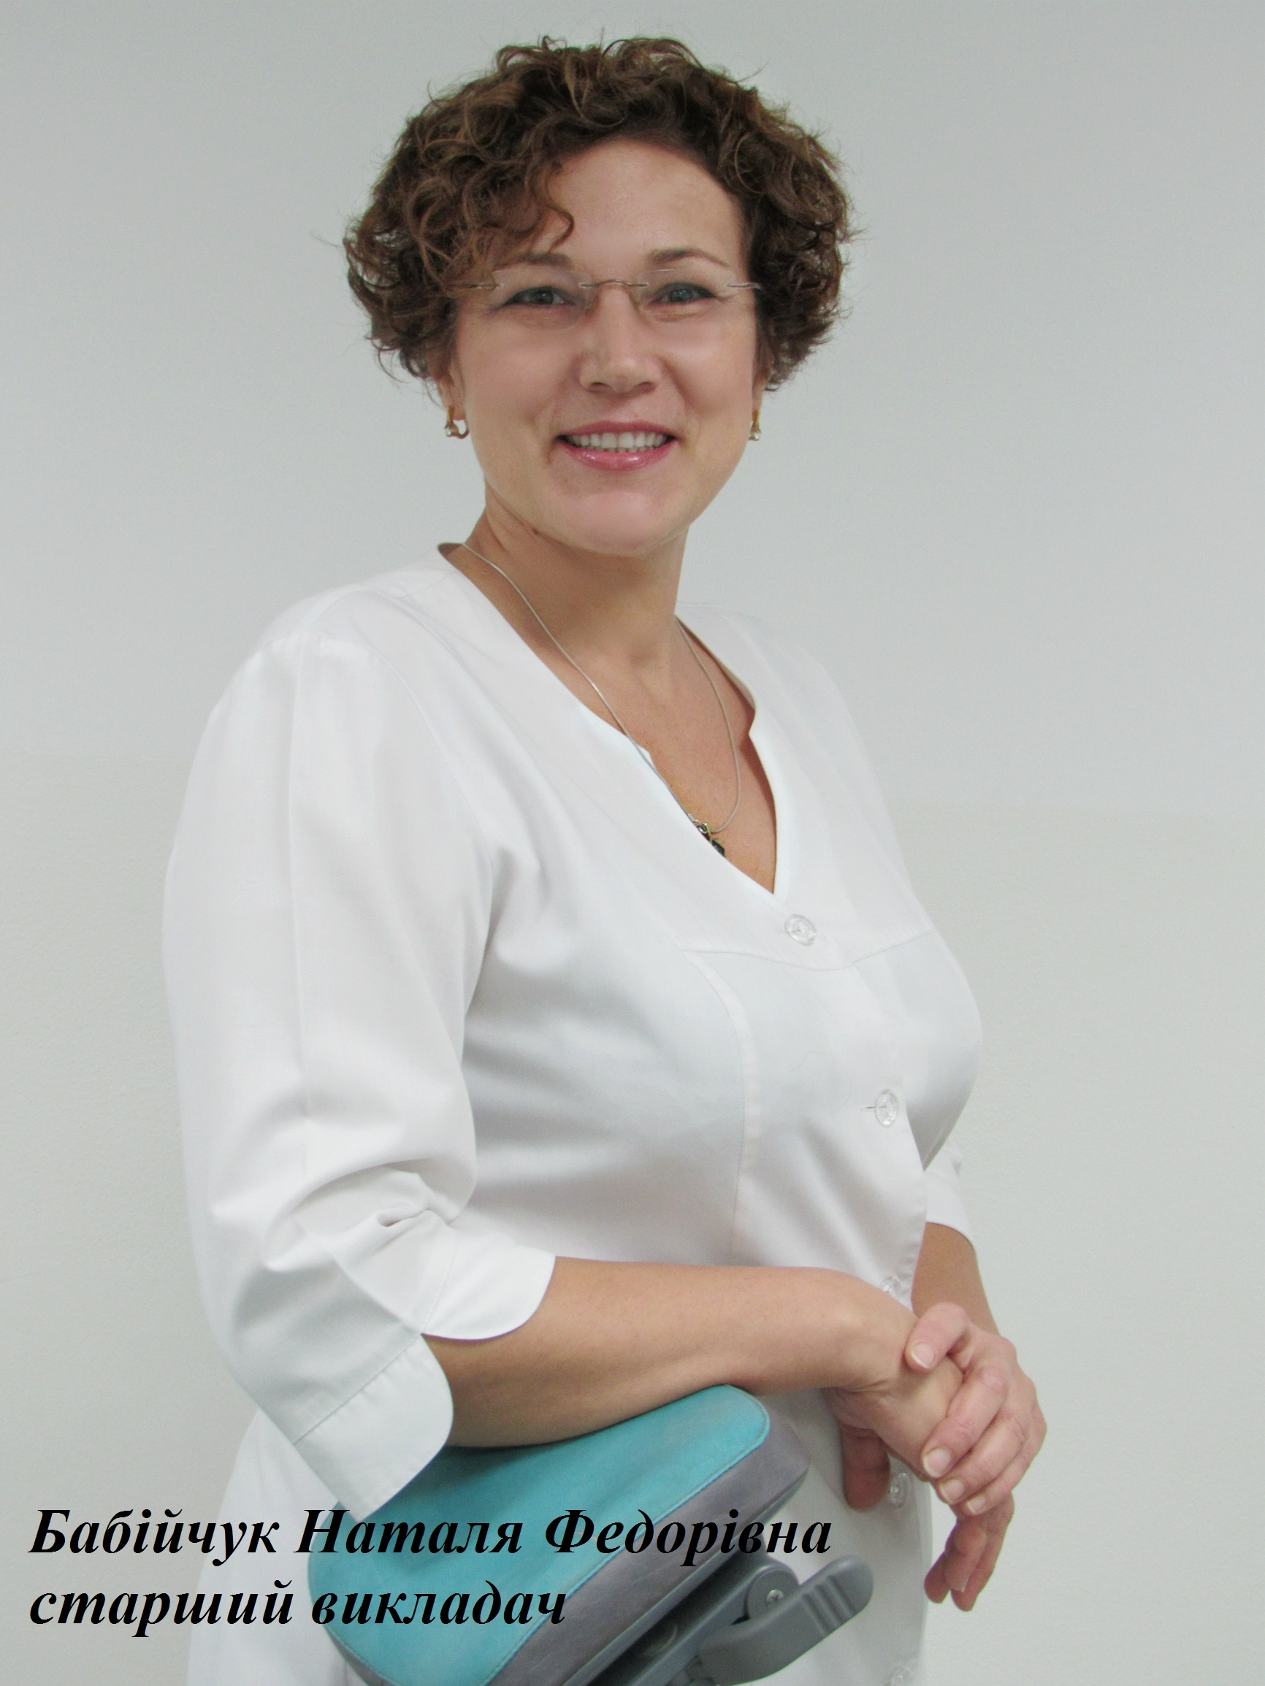
Contact information
COURSE DEVELOPERS
Contact information: Vinnytsia,34 Heroiv Politsii St. (entrance from the university grounds).
Department of Orthopedic Dentistry ort.stom@vnmu.edu.ua
www.vnmu.edu.ua
Babiichuk Nataliia, Senior Lecturer

