Slide 1
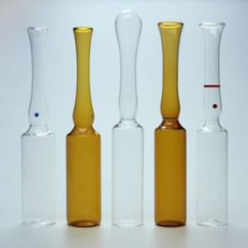

MINISTRY OF HEALTHCARE OF UKRAINE
VINNITSYA NATIONAL PYROHOV MEMORIAL MEDICAL UNIVERSITY
Department of Pharmacy
Packaging technology in the pharmaceutical industry
Elective course

Slide 2
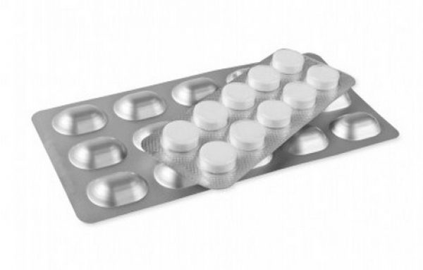
The main objectives of the course
Formation of theoretical knowledge and practical skills on the main technologies for packaging medicines;
Acquaintance with modern materials and new methods of packaging pharmaceutical products;
Studying of new innovative types of packaging for pharmaceutical products;
Acquaintance with modern packaging labeling technologies.

Slide 3
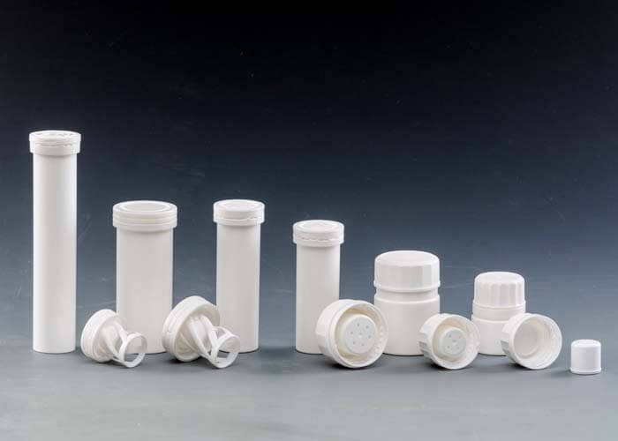
General information
Studying the course "Packaging technology in the pharmaceutical industry" will contribute to the rational choice of packaging for pharmaceutical products and provide the best consumer properties.

Slide 4
Learning outcomes
Knowledge of modern materials used for primary packaging of pharmaceutical products;
Knowledge of modern packaging methods for various dosage forms;
Knowledge of modern methods of pharmaceutical product labeling;
Understanding the influence of packaging on the consumer properties of pharmaceutical products;
Ability to choose materials and methods for obtaining various types of packaging;
Ability to choose a rational type of packaging for a certain type of dosage form.

Slide 5
Methods of teaching
Course of lectures and practical lessons;
Use of visual demos for each topic;
Work with up-to-date information about world achievements in this scope;
Use of modern pedagogical methods

Slide 6
Logistics support
Course of lecture.
Materials of scientific and practical conferences.
Visual and handout material for each topic in the discipline.
Normative legal documents.
Working with digital media.
Study guides and specially developed guidelines

Slide 7
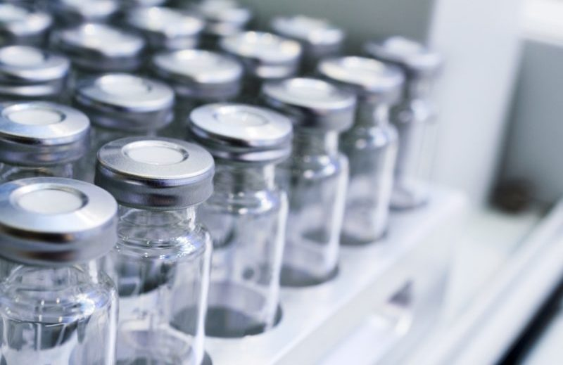
If you are interested in the question of modern experience technology packaging of medicines - our teaching staff will be happy to help you gain knowledge !!!!

