Slide 1

Clinical anatomy and operative surgery
Elective course
Modern strategies of operative surgery

Slide 2
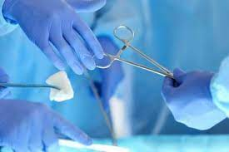
Relevance of the discipline
The discipline studies the rules and methods of performing surgical operations, taking into account the location of organs and their projection on the skin, methods.
As a discipline, it provides students with theoretical foundations and contributes to the acquisition of methodologically correct skills of operation, which are developed as a result of exercises on corpses, experimental and sick animals..
In the system of training specialists in the field of medicine, operative surgery is the theoretical basis for solving practical problems

Slide 3
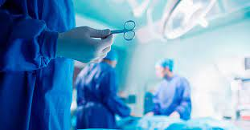
The purpose of the course: the formation of a holistic view of the structure, form, mutual placement of organs in parts of the human body and understanding of the principles, methods and techniques of surgery - the main objectives of the discipline are to form a system of professional skills. doctor

Slide 4
Course objectives Modern strategies of operative surgery
- Mastering systematic knowledge of the structure of the human body in different areas and the formation of practical skills of topographic and anatomical execution of operational accesses and operational techniques; - Mastering the skills of care for surgical patients, the basics of clinical examination of surgical patients; - Familiarity with the principles of surgical treatment and semiotics of major types of surgical diseases;
- mastering the skills of using surgical instruments, dissection and connection of soft tissues, temporary and permanent cessation of bleeding, technique of intestinal sutures and singing, access to the main vessels and nerves of the extremities, venesection and venipuncture, vascular ligation, mastery of surgical access and surgical techniques on cadaveric material or animals, as well as the acquisition of theoretical knowledge and practical skills in antiseptics, asepsis, anesthesiology, clinical manifestations of injuries, surgical infections, emergencies, basic principles of diagnosis, treatment and prevention.

Slide 5
Important topics of the course
Topic 1. Clinical anatomy of the anterior-lateral abdominal wall. Anatomical and physiological justification of access to abdominal organs. Surgical treatment of umbilical hernias and white line hernias. Surgical anatomy of the inguinal canal, its contents in men and women. Leather seam. Intestinal suture.
Topic 2. Clinical anatomy of the chest, the boundaries of the division into sections. Topographic anatomy of the subclavian area. Surgical interventions on the breast in purulent mastitis, benign and malignant neoplasms. Subclavian artery exposure and ligation, subclavian vein puncture. Topographic anatomy of the actual chest wall.
Topic 3. Bone base of the pelvis, bone joints, external landmarks for determining the size of the pelvis. Division into floors. The course of the peritoneum in the cavity of the male and female pelvis, folds, depths. Diagnosis and methods of drainage of pelvioperitonitis. Fascia and cellular spaces of the subperitoneal floor. Surgical anatomy of the pelvic organs: uterus, ovaries, bladder, prostate, rectum.
Topic 4. Clinical anatomy of the upper extremity. Division into sections. Boundaries, layers, vessels, nerves. Ways of spreading purulent processes on the upper extremity and incisions in them. Exposure of blood vessels and nerves in the upper extremity (surgery on cadaveric material). Tendon suture.
Topic 5. Clinical anatomy of the buttocks and lower extremities. Surgical anatomy of the hip joint. Hip puncture. Exposure and suture of the sciatic nerve. "Exposure and ligation of blood vessels of the extremities" (surgery on animals and corpses). Vascular suture.

Slide 6
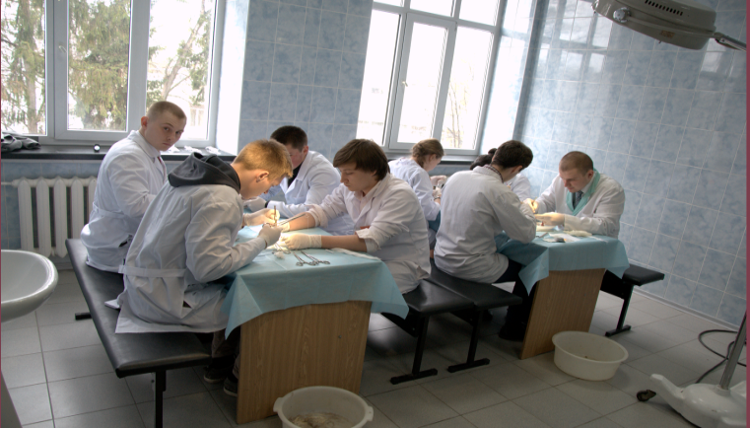
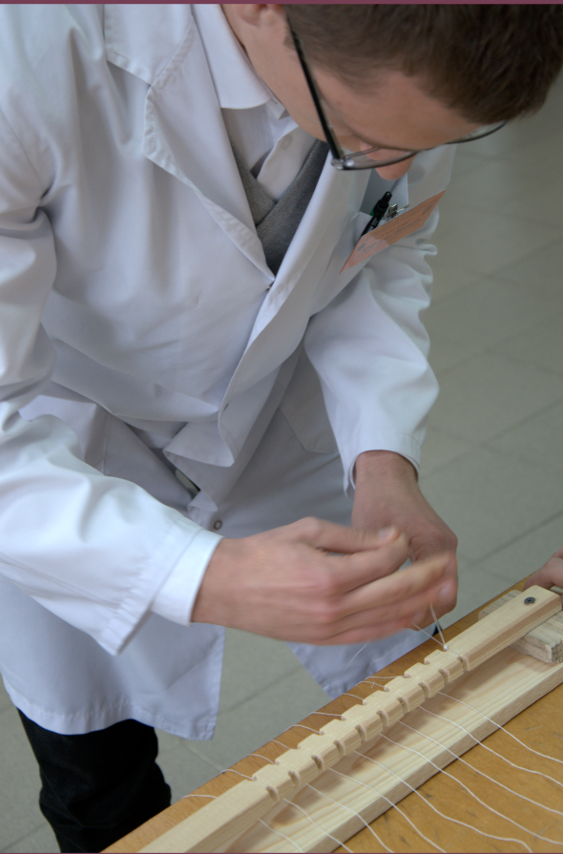
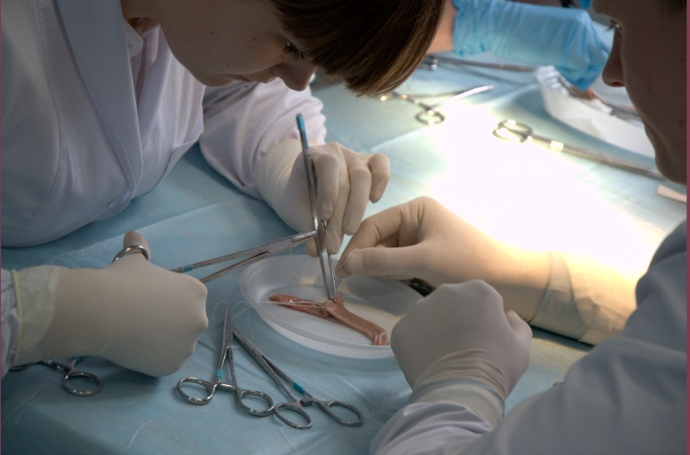
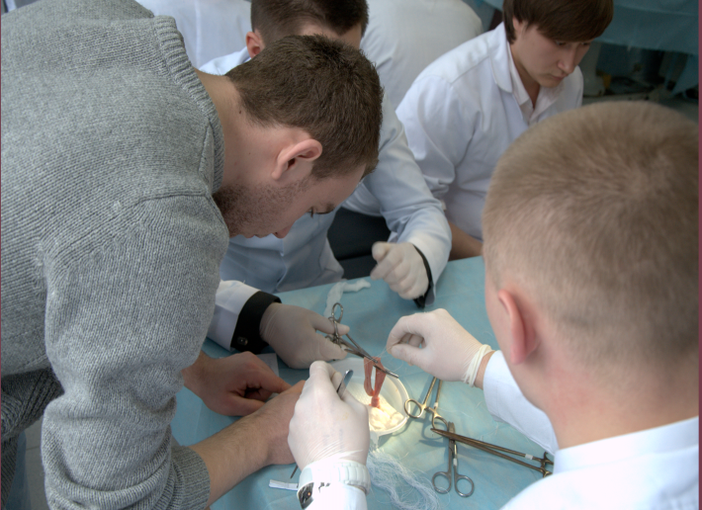
We invite you to the course
Modern strategies
operative surgery

