Slide 1


Applied genetics
MINISTRY OF HEALTH
NATIONAL PIROGOV MEMORIAL MEDICAL UNIVERSITY, VINNYTSYA
Department of Pharmacy
  Elective course

Slide 2

Relevance of the course
The discipline "Applied Genetics" studies the application of the achievements of general genetics in various spheres of human life and activity.
If you like genetics and you would like to know why the French can drink wine all their lives, and Eskimos immediately get alcoholism?
Why do the same drugs have different effects in different patients?
How can a haircut find a killer?
Who is "mitochondrial Eve"?
Do genes or upbringing determine a person's character and intellect?
Why are there more albino people on the African continent than in Europe?
You will find the answer to these and many other questions by choosing the course "Applied Genetics".

Slide 3

The purpose and objectives of the discipline
To form in future specialists basic knowledge of molecular genetics;
Promote the development of applied areas of genetics, such as genetic engineering, medical and genetic counseling, forensic genetics, epigenetics, pharmacogenetics, etc .;
Contribute to the successful training of specialists who will have general theoretical training, have the necessary competencies for further training and independent work of a pharmacist.
Provide fundamental training and formation of ideas about the practical use of modern scientific advances in genetics.

Slide 4
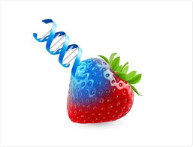
Learning outcomes:
Formation of modern ideas about the human genome;
Establish the concept of eco- and pharmacogenetics;
Knowledge of the list of mutagenic factors and systems of assessment of mutagenic activity;
Possession of methods of analysis of the genetic structure of the population;
Understanding the features of medical and genetic counseling and its stages;
Knowledge of ways of practical use of genetic engineering for identification of the person;
Ways of using genetic tools in forensic genetics;
Possession of modern ideas about genomics;
Knowledge of psychogenetic and pharmacotherapeutic approaches to the treatment of hereditary pathologies.

Slide 5
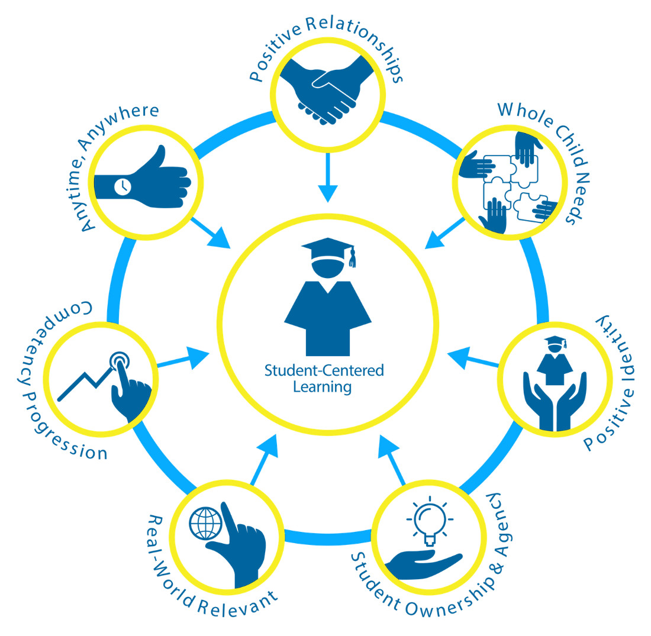
Forms and methods of teaching
The course includes lectures and practical classes.
The focus is on the formation of a model in which the key knowledge, skills and abilities that a higher education applicant must master are aimed at meeting his or her own needs and meeting his or her need in the labor market, high employability.
Use of interactive teaching methods, such as discussions, heuristic conversations, gamification of learning, use of technical teaching aids.
Excursion classes (both virtual and real), meetings with industry experts are planned within the course.

Slide 6

Material and technical providing a course
Author's course of lectures;
Meetings with interesting speakers;
Work with technical and digital teaching aids;
Free access to modern up-to-date sources of information;
Visual database of photos and videos;
Specially developed manuals and educational and methodical recommendations.
Textbooks, articles, materials of scientific and practical conferences.

Slide 7

Connection with other disciplines
The course is based on the acquired knowledge of "Biology with the basics of genetics" and "Cell Biology".
This course provides a high level of general biological training and lays the foundation for their further acquisition of knowledge in relevant theoretical and clinical professional and practical disciplines (medical chemistry, pharmaceutical botany, pharmacognosy, physiology, microbiology, pathophysiology, etc.).

Slide 8


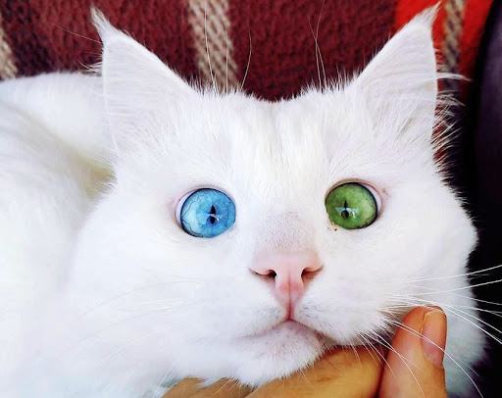
Approximate list of topics of the discipline
Medical genetics. The concept of hereditary human diseases.
Eco- and pharmacogenetics.
Epigenetic mechanisms of phenotype expression control.
Population genetics. Modern genetic monitoring of populations.
Genetic polymorphism of mankind.
Forensic genetics. DNA profiling.
Fundamentals of genomics and DNA databases.
Psychogenetics and genetics of human intelligence. Disorders of psycho-emotional development.

Slide 9
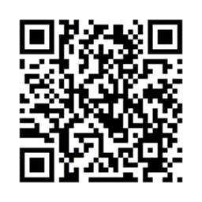
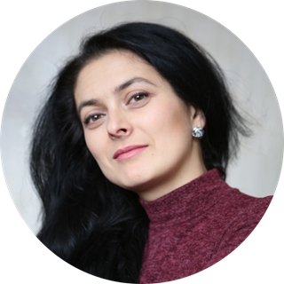
Course teacher
Shcherba Iryna Karimivna,
PhD of Biological Sciences, Associate Professor of Pharmacy, course developer

Slide 10
Thanks for your attention!
MINISTRY OF HEALTH
NATIONAL PIROGOV MEMORIAL MEDICAL UNIVERSITY, VINNYTSYA
Department of Pharmacy

