Slide 2

Modern problems of Molecular Biology
Ministry of Health of Ukraine
National Pirogov Memorial Medical University,
Vinnytsya, Ukraine
Elective Course for the 2nd year students of the Department of Pharmacy

Slide 3

This story is time-tested. And time, as you know, is a real measure of what, in fact, is worth of the attention.
Consequently, for more than 10 years we have had a great interest of students in the course “Modern Problems of Molecular Biology".

Slide 4
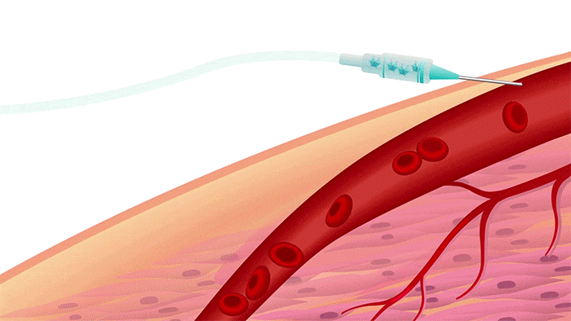
For students, the course has become a real window into the world of modern technology. Those that have long been the basis for the diagnosis and treatment of serious diseases, which formed the basis for the creation of new modern medicines and work with the cause of the disease at the molecular level.

Slide 5
The discipline includes sections: "Molecular bases of heredity", "Molecular bases of hereditary diseases", "Modern issues of gene technologies".
Course lays the foundation of students’ further study of:
- the main methods of chemical analysis;
- the structure and functions of biopolymers (proteins and nucleic acids);
- understanding the molecular basis of Genetics of hereditary and multifactorial diseases;
- the modern state and perspectives for applying the achievements of Molecular Biology in practical Medicine, namely in Molecular Genetic Diagnostics, Pharmacology and in Gene Therapy.

Slide 6
Studying the elective course "Modern Problems of Molecular Biology" also lays the foundation for further mastering by students of knowledge and skills in specialized theoretical, professional-practical and clinical disciplines (e.g. Bioorganic Chemistry, Pharmacology, Physiology, Medical Genetics, etc.).
Current training discipline also provides the study of modern problems and achievements of molecular medicine.
Teaching the discipline includes lectures, practical exercises, independent work of students, consultations and ends with a final test control.

Slide 7
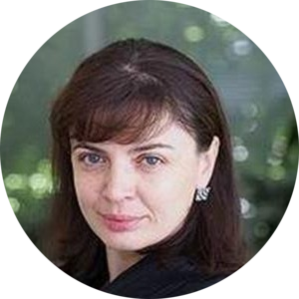
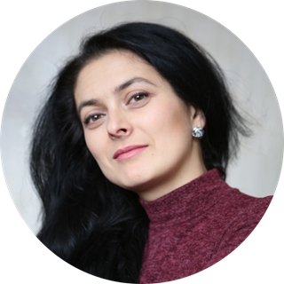
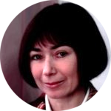
Teachers of the Course:
Dr. Sci. Biol., Victoria Rodinkova
Professor of the Department of Pharmacy, Fulbright Scholar, Prof., Author of the Course
PhD in Biology, Shcherba Iryna, Associate Professor of the Department of Pharmacy
PhD in Biology, Olga Palamarchuk, Associate Professor of the Department of Pharmacy

Slide 8
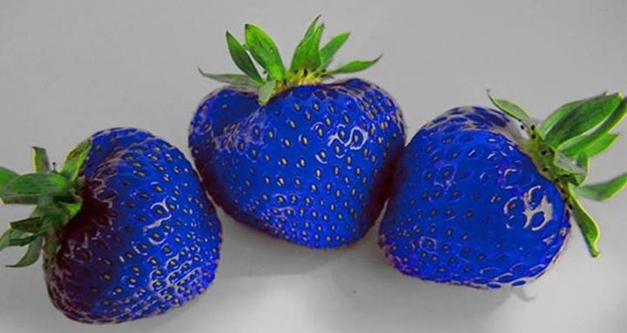
We are waiting for you!
And thanks for your attention!

