Slide 1

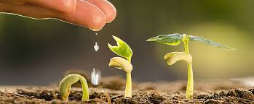
Elective course
“Cultivation of the medicinal plants”
Ministry of Health of Ukraine
National Pirogov Memorial Medical University,
Vinnytsya, Ukraine

Slide 2


Teacher: Assistant Professor, PhD
Krykliva Svitlana Dmytriivna
Teacher: Assistant Professor, PhD
Bobrovska Olena
Anatolivna

Slide 3
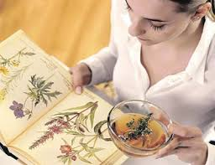
Plant life has been the source of material and spiritual food for centuries.
Despite rapid development of chemical science, invention of effective synthetic medicines, medical herbs retain their importance in treatment of various diseases.
The aim of the training discipline
“Cultivation of the medicinal plants” is to achieve the rational exploitation of the medical herb resources, conceive the technology of their cultivation and storage, as well as their use in pharmaceutical industry.

Slide 4
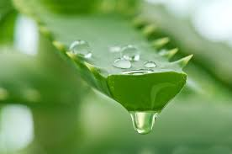
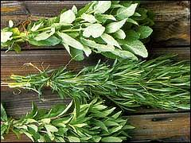
Task of the training discipline is to consider the detailed classification of medicinal plants not only by origin and degree of their naturalization but also by botanical reference and agricultural use;
The Course also considers classification of plants by the substance, which is accumulated as the main one and by the organs that are used to prepare medicationsand their action and even the main application.

Slide 5
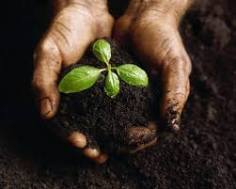
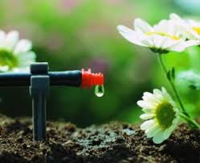
In the rate of the Course compulsory is studying some features of agrotechnics of cultivation of annual, perennial herbal and woody medicinal plants.
Namely: soil treatment, making fertilizers, the preparation of seeds and planting material, rules of landing, plantations’ control.
The impact of various factors on the raw medicinal plant material’ quality is considered too.

Slide 6
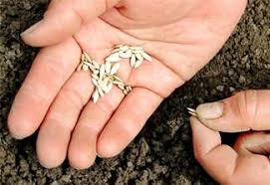
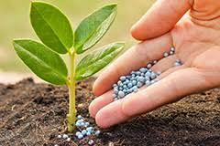
Separately, attention is paid to the requirements for the collection of various types of medicinal raw materials, depending on the phenological phases of plant development (the beginning of the growing season, budding, flowering, fruiting, the end of the growing season), its further drying (air, air-shadow, air-solar, thermal, lyophilization) and storage (conditions, term, temperature, humidity).

Slide 7
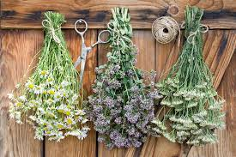
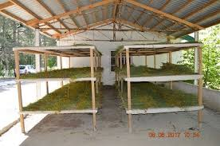
Preceding Subjects:
The Elective Course is based on students knowledge on Pharmaceutical Botany, Inorganic Chemistry, Organic Chemistry, Information Technology In Pharmacy, Latin and Ukrainian languages.
Subsequent Subjects:
The given elective course performs an important role for biological pharmacy-related disciplines and also lays a basis of study Economic Botany, Pharmacognosy, Field Practice on Pharmaceutical Botany, Educational Practice in Pharmacognosy and Pharmacology.

Slide 8

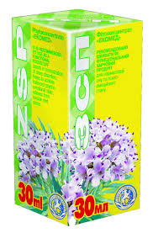
Themes of training discipline:
Classification of medicinal plants.
Agrotechnics of cultivation of medicinal plants.
General methods of medicinal plants’ cultivation.
Cultivation of medicinal plants, in which the aerial part is used as a medicinal raw material.
Cultivation of medicinal plants, in which the underground part is used as a medicinal raw material.
Cultivation of medicinal plants in greenhouses.
Cultivation of medicinal plants, harvested as fruit and berry.
Cultivation of medicinal plants, harvested as agricultural.

Slide 9
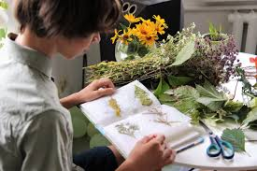
Teaching methods:
Verbal – lecturing, telling stories from practice, explanation, conversation, discussion, instruction, work with a educational and scientific resources including Internet ones;
Visual – demonstration of natural objects, micropreparations, tabular clarity, images with the help of information technology, demonstration of techniques, illustrations, handouts (fresh, fixed or dry plant material, fruit collections, sets of herbarium specimens on the morphology of vegetative and generative organs, models, herbarium of medicinal plants);
Practical – practical work, which involves the study of macro- and microstructures of plant objects, herbarium specimens, plant identification.

Slide 10

Methods of Control: test tasks, herbarium samples, vegetable raw materials, situational tasks, abstract reports, test computer control, list of questions for the final control.
Learning outcomes: Students learn the material on the role and significance of medicinal plants in traditional and alternative medicine; on classification of medicinal plants, diagnostic signs that are important in the identification of medicinal plant materials; morphology of the vegetative and generative organs of plants, their diversity; elements of plant cultivation technology depending on natural factors: soil preparation, planting, plant care; rules for storing of medicinal plants and rules for determining the quality of medicinal raw materials.

Slide 11
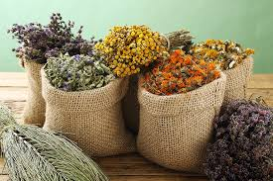
Thus, during the study of the course "Cultivation of the medicinal plants", applicants consider about 30 technological maps of plant cultivation with the subsequent possibility of their application in research areas of indoor or open ground, with the possibility of medicinal plants cultivation in order to obtain high-quality raw plant material.

