Slide 1
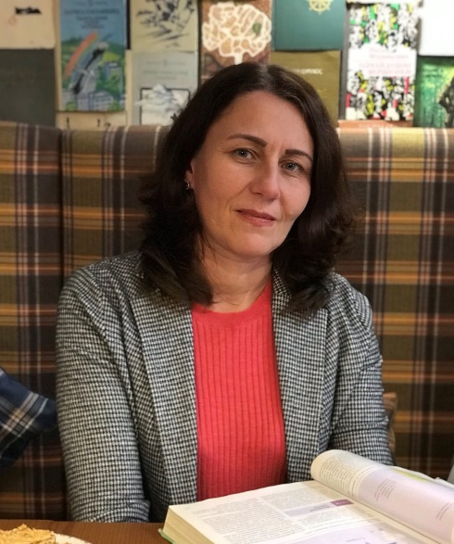
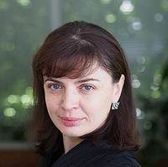

Biological essentials of active longevity
Ministry of Health of Ukraine
National Pirogov Memorial Medical University,
Vinnytsya, Ukraine
Elective Course for the 2 (3)-year students of the Departments of Pharmacy and Medicine
Professor of the Department of Pharmacy, Head of the Laboratory of Allergenic Environmental Factors’ Investigation at the National Pirogov Memorial Medical University, Fulbright Scholar, Prof., Dr. Sci. Biol., Victoria Rodinkova
Associate Professor of the Department of Pharmacy at the National Pirogov Memorial Medical University, PhD in Biology, Svitlana Krykliva

Slide 2
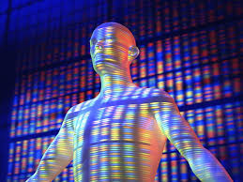
Two decades ago, the human genome was considered a species trait, equally inherent in all members of a biological species.

Slide 3
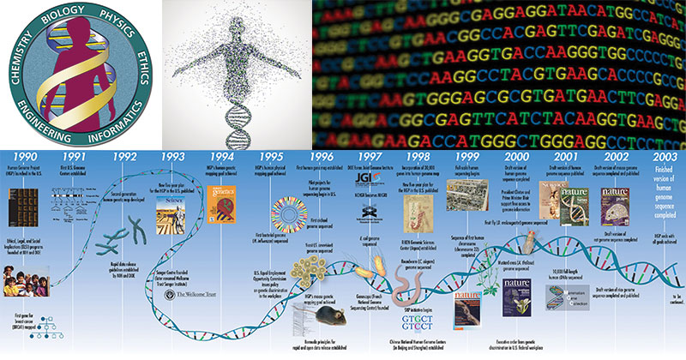
DNA research and technology as well as recent developments in Biology and Medicine have drastically changed this view.
Consequently, it became obvious that our health, life expectancy and activity depend on individual combinations of gene material, on the influence of our environment, on the way we behave and eat.

Slide 4
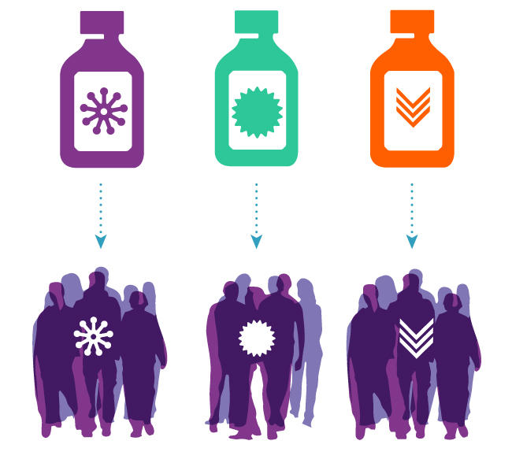
Personalized Medicine and Pharmacy have been developed, which determine the best combination of medicines for a person, strategies for the selection of dietary supplements and shape his/her lifestyle.

Slide 5
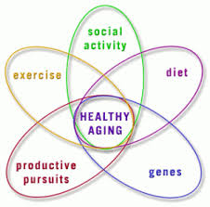
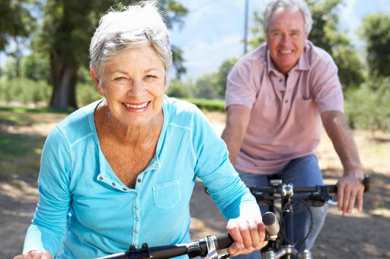
It has already been proven that with each generation a person's life is prolonged. Thus, how to maintain health after years, what processes in the body to monitor and how to correct these processes so as to maintain activity for decades?

Slide 6
The course "Biological Essentials of Active Longevity" will help you to answer these questions.
It is designed for students who have studied Courses of Medical Biology and Genetics.
In the course, you will learn about the biological processes that control the pathways of physiological development, functioning and aging of our body, about the modern possibilities of selecting optimal nutrition based on artificial intelligence technologies and technologies based on systems biology, which expands knowledge about the effect of diets on human health.
You will get closer to understanding both habits and thinking, which will become the basis of your active healthy lifestyle in future.

Slide 7
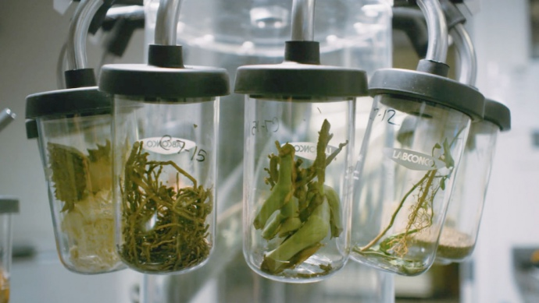
The course, among all, fits into the Health Paradigm: Prevention through personalized selection of diet and dietary supplements.
In December 2020, it was identified by the World Economic Forum as one of the seven technologies that could change the world by 2025.

Slide 8

The course will be developed with the support of the University of Functional Medicine.
It will be of interest to doctors, representatives of the pharmaceutical industry, who will promote the issues of a healthy lifestyle, as well as to a wide range of public.

Slide 9

Thanks for your attention!

