Slide 1

National Pirogov Memorial Medical University, Vinnytsya
Department of Pharmacy
Elective course
"State regulation and control
in pharmacy »
training for second level specialist (master’s) of higher education
qualification of educational "Master of Pharmacy"
qualification of professional "Pharmacist"
field of knowledge 22 "Health"
specialty 226 "Pharmacy, industrial pharmacy"

Slide 2

elective course
"State regulation and control
in pharmacy »
► It belongs to the cycle of disciplines of professionally-oriented training of specialists in the specialty 226 "Pharmacy, industrial pharmacy".
► This discipline provides higher education students with basic knowledge about organizational, legal and economic mechanisms of the state regulation of pharmaceutical activities, the procedure for state control and supervision in the field of pharmaceutical activities.
► This discipline is an important link in shaping the profile of the Master of Pharmacy.
► This discipline refers to an elective discipline.

Slide 3

The purpose of teaching an elective course
"State regulation and control
in pharmacy »
Formation of higher education students' basic knowledge about socio-economic mechanisms of the health care system, tools for state regulation of the pharmaceutical industry.
Acquisition of systematic knowledge on legal, economic and organizational issues of management, taking into account regulatory and legal support and international standards.
Mastering the theoretical foundations of state control in the field of pharmaceutical activity.

Slide 4


Main objectives are :
formation of professional knowledge, skills and important professional skills of the student regarding:
► use of modern approaches for the management of pharmaceutical companies;
► study of the regulatory framework for regulating the activities of pharmaceutical companies;
► study of the procedure for state control and supervision over the work of economic entities on quality assurance of medicines in the process of their manufacture, retail and wholesale trade.
► study of the system of state financial control and audit activity in Ukraine.

Slide 5



Advantages of the course
This course will ensure the formation of students' theoretical foundations and the acquisition of systematic knowledge on:
1. organizational structure of the pharmaceutical industry;
2. socio-economic mechanisms of state regulation of pharmaceutical activities (lending, insurance, taxation, pricing);
3. economic instruments for regulating foreign economic activity;
4. systems of state control over the quality assurance of medicines, the procedure for inspections and supervision in the field of pharmaceutical activities, appeals against decisions of regulatory authorities.

Slide 6
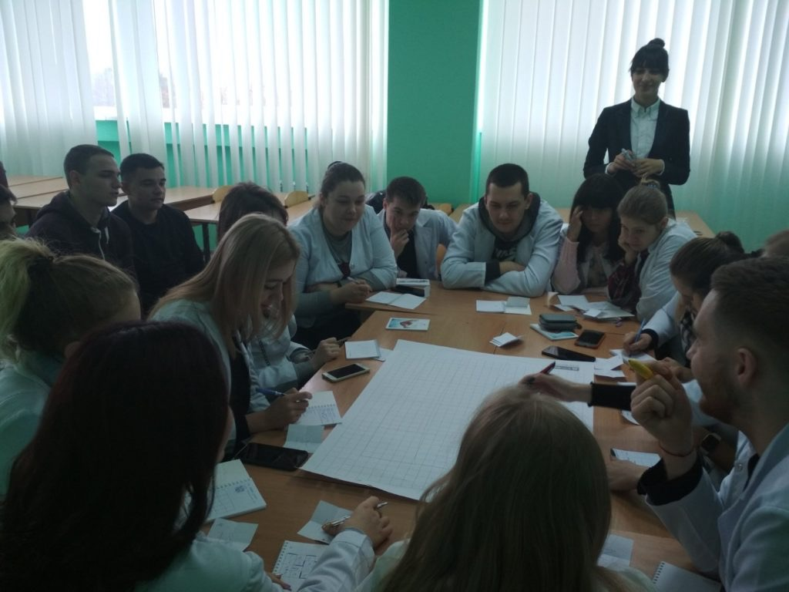

Learning methods
-verbal (story, explanation, conversation);
-explanatory-demonstration (multimedia lectures with elements of audio);
-visual (display of management, financial statements, permits of the pharmacy);
-inductive (generalization of observation results);
-interactive methods (discussion with the invitation of specialists, brainstorming, business (role) games, trainings, master classes);
-practical methods (work with the regulatory framework and reporting of the pharmacy).

Slide 7

Logistics
To conduct the educational process, the Department of Pharmacy has the appropriate logistics:
-equipped classrooms, computers connected to the Internet, laptops, multimedia projectors, scanners, printers;
-materials of presentations of lectures with audio accompaniment;
-methodical recommendations for practical classes and independent work of students;
-list of theoretical questions for final control;
-test tasks;
-situational tasks.

Slide 8


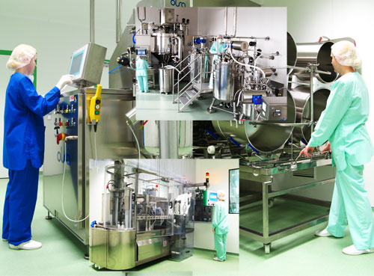
Elective course
"State regulation and control in pharmacy"
will bring you closer to professional activity, will provide important practical skills on legal, economic and organizational issues of management of pharmaceutical companies, and as a result will ensure your competitiveness in the labor market as a specialist!

Slide 9

CHOOSE A COURSE
"State regulation and control in pharmacy"
DISCOVER YOUR POTENTIAL WITH US!

