Slide 1
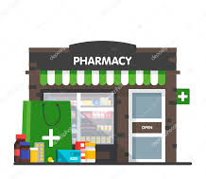

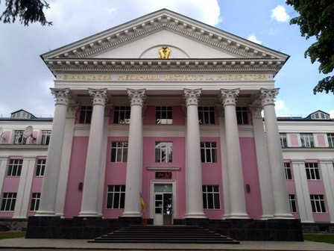

National Pirogov Memorial Medical University, Vinnytsya
Department of Pharmacy
ELECTIVE COURSE
Own business . PHARMACY
Training for specialists in the field of knowledge 22 « Health »

Slide 2


i want to open a …
pharmacy ?
Mini-market ?
pharmacy point?
pharmacy
warehouse ?

Slide 3
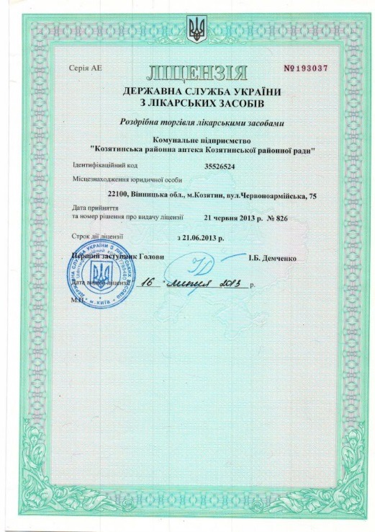


Where to start when you want to open a pharmacy ?
Відкрити аптеку: з чого почати?
To open a pharmacy, the owner does not need to have a pharmaceutical education, but for other requirements
you need to know their consequences and conditions. There are specific requirements for each type of
pharmacy. And there are many requirements that are not so easy to overcome
Licensing requirements

Slide 4


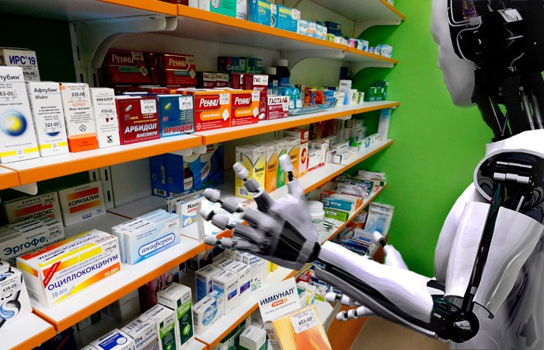

Our teamwork will help you find answers:
-Who is an entrepreneur?
-Doing business in Ukraine.
-From idea to business plan and business model.
-Taxation of the pharmaceutical business in Ukraine.
-Legal aspects - how to protect the interests of a pharmaceutical institution.
-How to find a place in the market.
-How to form a team.
-Enterprise life cycle and how to succeed in it.
-Management aspects of one's own business.

Slide 5



After completing the course what can you do by yourself?
-Pass the state registration of the enterprise and create the subject of economic activity.
-Choose the legal form of ownership.
-Make the perspective plan of development (Business plan) of the pharmaceutical enterprise.
-Select the appropriate tax system.
-Choose a room that meets the requirements of the legislation for pharmaceutical companies.
-Prepare the documents required to obtain a license, submit them to the licensing authority and obtain a license.
-Find reliable suppliers and contractors, prepare and enter into appropriate agreements with them.

Slide 6



Methods of learning
Teaching methods:
-Verbal (story, explanation, conversation);
-Explanatory-demonstration (multimedia lectures with audio accompaniment);
-Visual (demonstration of short videos, showing the work of pharmacies);
-Inductive (generalization of observation results).
-Our meetings include the use of advanced computer technologies, business games, conferences, conversations, discussions, dialogues, consultations, competitions, brainstorming technologies, case studies, trainings.
-Our meetings are attended by modern heads of pharmaceutical companies, managers, representatives, coaches, inspectors.

Slide 7

Logistics
To conduct the educational process, the Department of Pharmacy has full logistics:
-Equipped classrooms, computers connected to the Internet, laptops, multimedia projectors,scanners, printers;
-Materials of lecture presentations with audio accompaniment;
-Methodical recommendations for practical classes and independent work of students;
-List of theoretical questions for final control
-Test tasks;
-Situational tasks.

Slide 8



Motto Financial leader of the future

Slide 9


Progress with specialists

