Slide 1


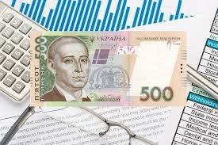
National Pirogov Memorial Medical University, Vinnytsya
Department of Pharmacy
ELECTIVE COURSE
ANALYSIS OF ECONOMIC ACTIVITY OF PHARMACEUTICAL ENTERPRISES
training for second level specialists (master’s) of higher education
qualification of educational "Master of Pharmacy"
qualification of professional "Pharmacist"
Area of ​​Knowledge 22 "Health"
specialty 226 "Pharmacy, industrial pharmacy"

Slide 2

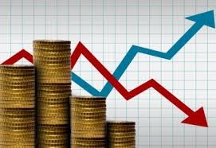
Course Characteristics
-The elective course "Analysis of economic activity of pharmaceutical companies" belongs to the cycle of disciplines of professionally-oriented training of specialists in the specialty 226 "Pharmacy, industrial pharmacy".
-The discipline provides higher education students with basic knowledge on the analysis of economic activity of business entities, mastering the organization and methodology of economic analysis, the formation of the ability to use theoretical knowledge in practice, based on the conceptual foundations of market economy.
-This discipline is an important link in shaping the profile of the Master of Pharmacy.
-This discipline refers to an elective discipline.

Slide 3


Course Characteristics
The financial condition of the company is characterized by a set of indicators that reflect the process of formation and use of its funds.
In a market economy, the financial condition of the company essentially reflects the final results of its activities. It is the final results of the company that affect the quality of pharmaceutical care to the population and the level of availability of medicines in pharmacies.

Slide 4
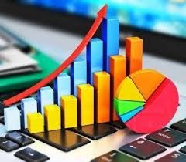

The objectives of the course are:
-Formation of professionally important knowledge, skills and abilities of higher education students in conducting economic analysis of pharmacy enterprises
-Acquisition of system knowledge about the set of indicators that reflect the process of formation and use of financial resources of the pharmacy enterprise;
-perfect knowledge of methods and techniques of financial analysis of pharmacies.

Slide 5


Advantages of the course
This course involves mastering the material on:
-identification of key indicators of economic analysis, such as profit, income and profitability;
-ability to make the right management decisions based on economic calculations;
-implementation of forecasting and planning of economic processes for the development of programs and recommendations for further effective development, profitable activities of the enterprise.

Slide 6
Program learning outcomes (PLO):
PLO 10. Adheres to the norms of communication in professional interaction with colleagues, managers, consumers, works effectively in a team.
-PLO 11. Uses methods for assessing performance indicators; identify reserves to increase labor efficiency.
PLO 20. Carries out a set of organizational and managerial measures to provide the population and health care facilities with medicines and other products of the pharmaceutical range. Carries out all types of accounting in pharmacies, administrative records, processes of commodity analysis.
PLO 21. Calculates the main economic indicators of pharmacies, as well as taxes and fees to form all types of prices (wholesale, purchase and retail) for medicines and other products of the pharmaceutical range.
PLO 24. Plans and implements professional activities on the basis of regulations of Ukraine and recommendations of good pharmaceutical practice.

Slide 7

Forms and methods of teaching
Methods of study :
-verbal (story, explanation, conversation);
-explanatory-demonstration (multimedia lectures with audio elements);
-visual (demonstration of short videos, showing the work of pharmacies);
-inductive (generalization of observation results).
-Our meetings include the use of advanced computer technologies, business games, conferences, talks, discussions, dialogues, competitions, various innovative technologies, training.
-Our classes will be attended by modern heads of pharmaceutical companies, managers, representatives, coaches, inspectors.

Slide 8

Logistics
To conduct the educational process, the Department of Pharmacy has full logistics:
equipped classrooms, computers connected to the Internet, laptops, multimedia projectors, scanners, printers;
materials for presentations of lectures with audio accompaniment;
Methodical recommendations for practical classes and independent work for students;
List of theoretical questions for final control
Tests
Situational tasks

Slide 9


So, for those who want to be fluent in all methods of economic analysis, who want to have a profitable pharmacy, who want to be able to predict bankruptcy and know all the ways to overcome it - then join us, for the course "Analysis of economic activity of pharmaceutical companies" !! !!

Slide 10


Thank you !

