Slide 1

Do you want to upgrade your knowledge and skills?
Then you’ve come to the right place!
Invites 4th-6th year students
of Medical Faculty
for a FREE COURSE:
"Practical ophthalmology for general practitioners"

Slide 2
Advantages of the course
Studying in small groups (5 people only)
Work in the stimulation center on modern equipment
Practice of practical skills to full mastering on models
30 case studies, which represent the most common ophthalmological diseases
Opportunity to visit and get acquainted with the work of modern privat ophthalmological clinic

Slide 3
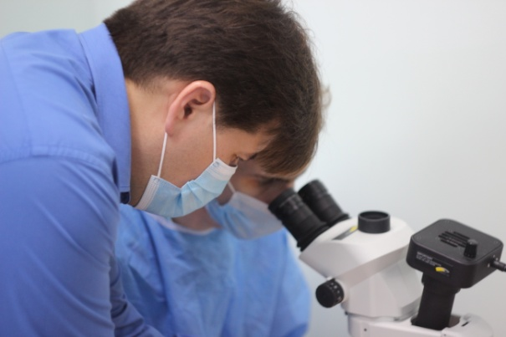
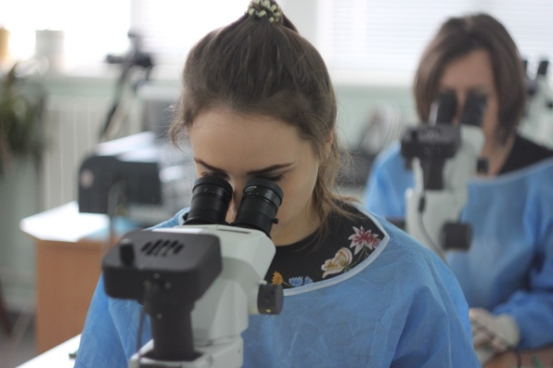
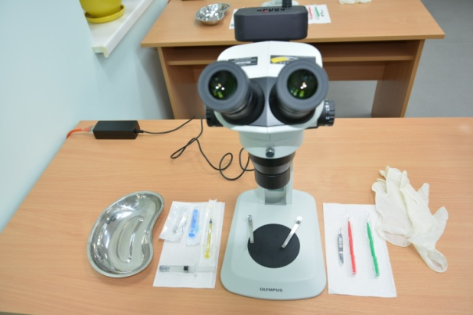
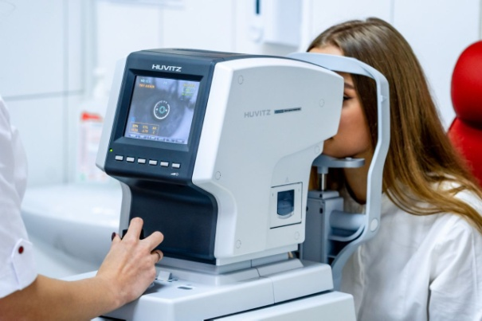
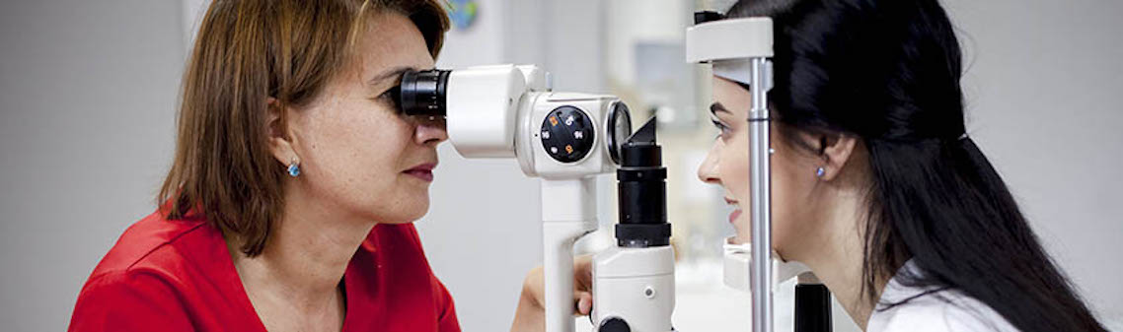
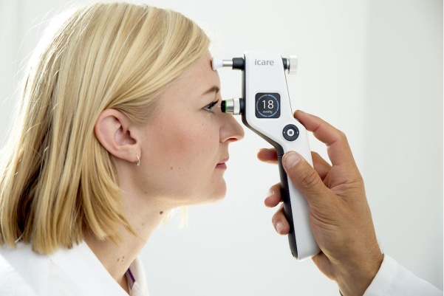
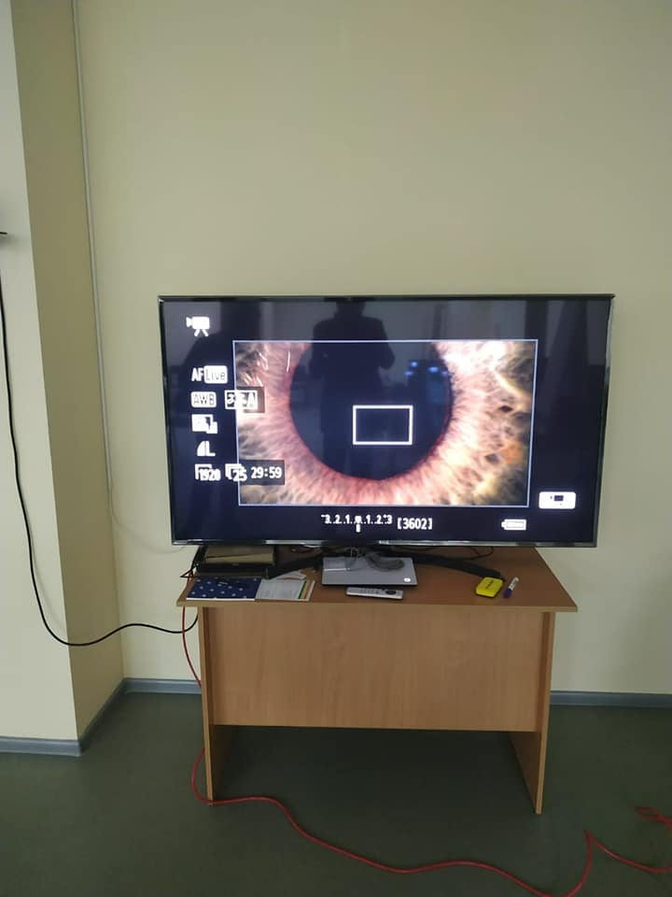
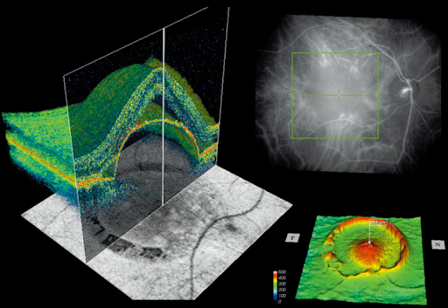

Slide 4

Even more!
Successful completion
"Course of practical ophthalmology for a general practitioner (family medicine)”
will provide advantages when enrolling in a clinical internship in the specialty "Ophthalmology".

Slide 5
Sounds interesting?
We recommend you to read the full information of the course…

Slide 6
Contents of program materials
The procedure and standards for providing care to patients with ophthalmological diseases.
Screening of the population on the most common ophthalmic diseases (Dry eye syndrome, Age-related macular degeneration, Primary open-angle glaucoma, Binocular vision disorders, Diabetic retinopathy, Cataracts)
Methods of research of the vision organ in patients of different age groups. Examination of visual acuity, including with the help of a projector test marks. Determination of refraction. Introduction to computer perimetry. Research in focal lighting. Research in transmitted light.
Ophthalmoscopy (direct, reverse). Introduction to biomicroscopy, ultrasound of the eye, OST, modern means of visualization of eye structures and the possibility of on-line counseling.
Modern methods for determining intraocular pressure. Violation of regulation of intraocular pressure.

Slide 7
Contents of program materials
Algorithm of providing emergency care in an acute glaucoma attack.
Algorithms for diagnosis and first aid to patients with inflammatory diseases of the visual organ, accompanied by the syndrome of "Red Eye" indications for referral to an ophthalmologist.
Algorithms of diagnosis and first aid for patients with sudden vision loss, indications for referral to an ophthalmologist.
Dispensary observation of patients with ophthalmopathology.

Slide 8
List of practical skills
Level of skills development:
1 - have an idea, be professionally oriented, know the indications
2 - know, evaluate, participate
3 - perform independently

Slide 9
List of practical skills
1. Clinical examination of the patient
1.1 Complete clinical examination of the patient: history, examination, palpation (2-3)
1.2 Formulate and justify the preliminary diagnosis (2-3)
1.3 Make a plan for examination of the patient (2-3)
1.4 Make a treatment plan based on the previous diagnosis (2-3)
1.5 Formulate a complete diagnosis, make the necessary differential diagnosis (2-3)
2. Instrumental research methods.
2.1 Use of questionnaires for screening the most common ophthalmic diseases (3)
2.2. Amsler's Grid (3)
2.3. Special researches: computer perimetry (1-2)
2.4. OCT (1-2) 2.5. Ultrasound of the eye (1-2)

Slide 10
List of practical skills
3. Therapeutic and diagnostic procedures
3.1 Examination of visual acuity (2-3)
3.2 Determination of the type and degree of refraction by subjective methods (2-3)
3.3 Investigation of the field of view in an approximate way (2-3)
3.4 Method of examination by lateral illumination of the anterior segment of the eye (1-2)
3.5 Methods of research in transmitted light (1-2)
3.6 Methods of examination of the fundus (ophthalmoscopy) (2-3)
3.7 Method of determining intraocular pressure (2-3)
3.9 First aid for emergencies:
Acute glaucoma attack (2-3)
Visual trauma (2-3)
Sudden loss of vision (2-3)
Red eye syndrome (2-3)

Slide 11
List of practical skills
4. Documentation, organization of medical business
4.1 Completion and maintenance of clinical history, extracts from medical history, referral to an ophthalmologist (3)
4.2 Completion and maintenance of medical documentation of the outpatient card; certificate of incapacity for work; referral for hospitalization; sanatorium-resort card and others (2-3)
4.3 Medical and social examination: - referral to MSC - making an informed decision on the state of working capacity - participation in the preparation of an individual program of rehabilitation measures for the prevention of disability (2-3)
4.4 Organization of medical examination at the site, analysis morbidity with temporary disability (1-2)

Slide 12
Assessment
Final certification includes two parts:
1st part: Independent analysis of a clinical problem (attestation test of intermediate attestation, conducted orally with the use of telecommunication technologies).
2 ^{nd} part: performance of practice-oriented tasks (conducted in the simulation center)
The final grade for the exam is set by a group of teachers in the aggregate based on the evaluation of the results of the clinical task analysis and the implementation of practice-oriented part of the exam

Slide 13


LOOKING FORFARD
FOR MEETING YOU!
Where to find us?
Department of Ophthalmology M. Pyrohova VNMU
votcup.com

