Slide 1

Want to know and be able to do more?
Then you have come to the right place!
Invites students of IV-VI course
Medical Faculty
for a FREE COURSE:
"Pharmacotherapy in ophthalmology"

Slide 2
Advantages of the course
Studing in small groups
Work in research laboratories of the university on modern equipment
Familiarization with the rules and requirements of clinical trials of pharmacological drugs in ophthalmology
Analysis of clinical cases that reflect the most common ophthalmic diseases
Opportunity to visit and get acquainted with the work of modern private ophthalmology clinics and doctors working in clinical trials

Slide 3
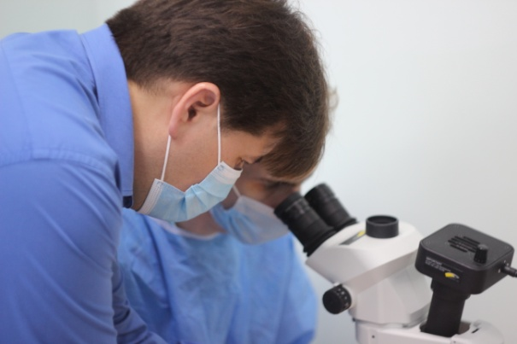
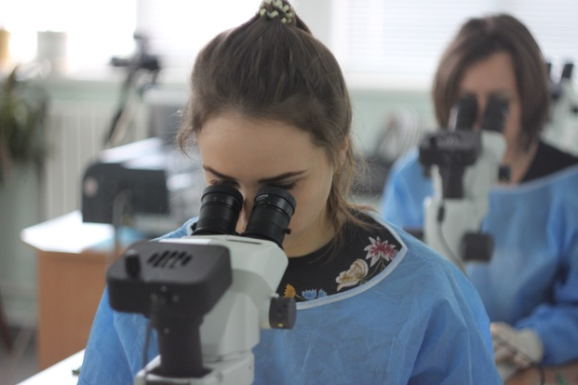
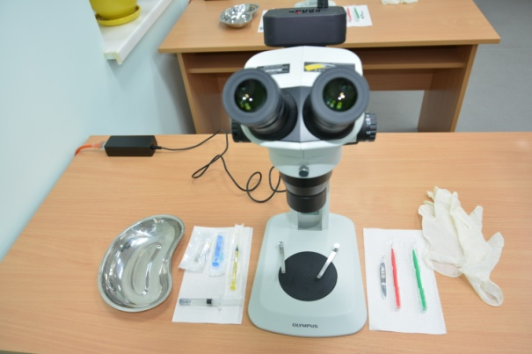
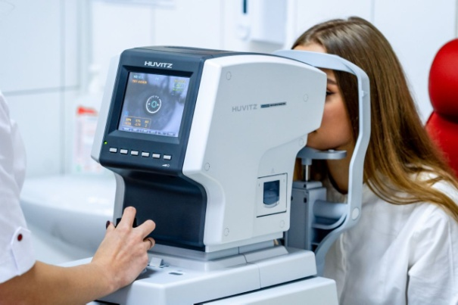
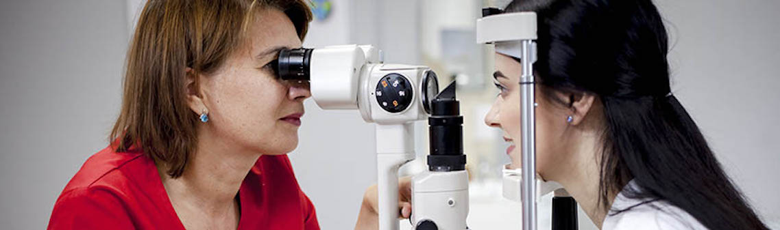
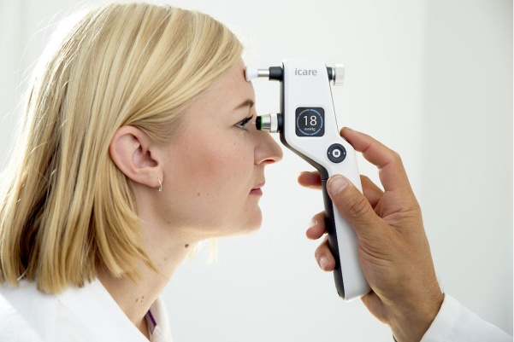
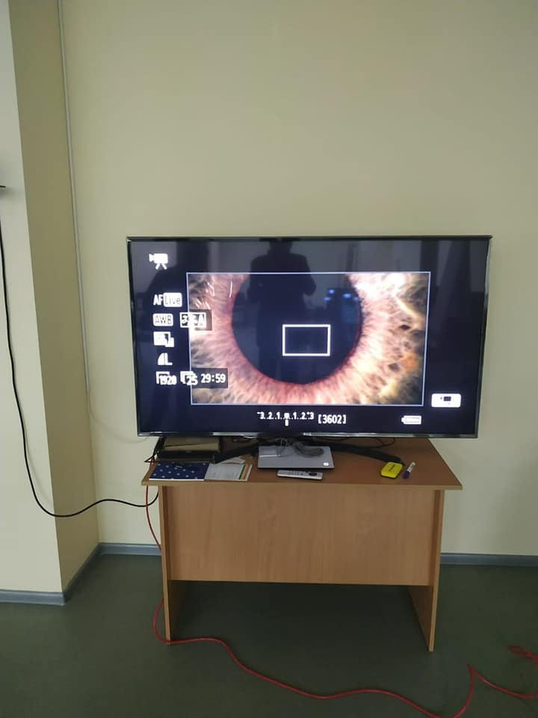
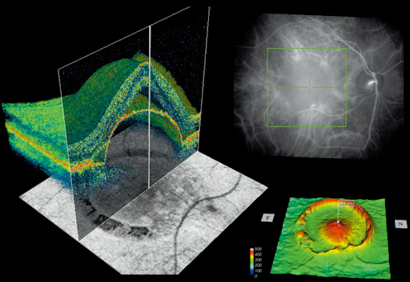

Slide 4
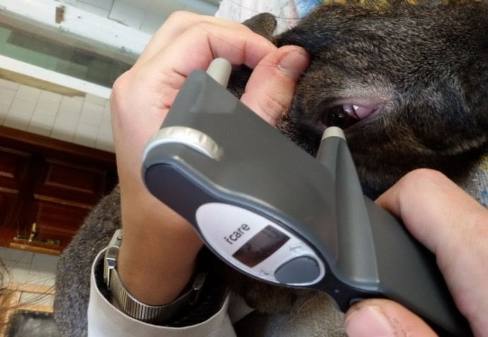
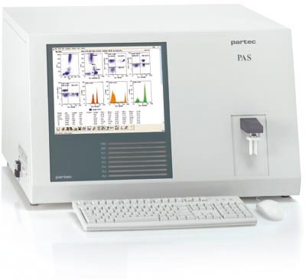

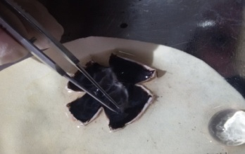
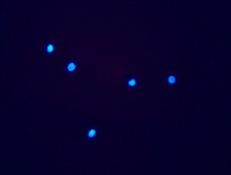
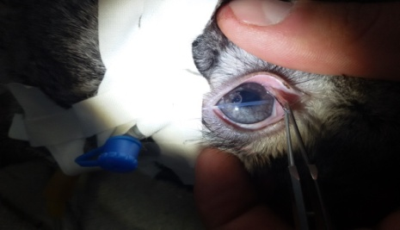
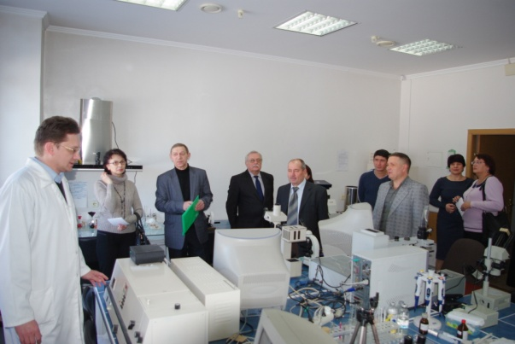
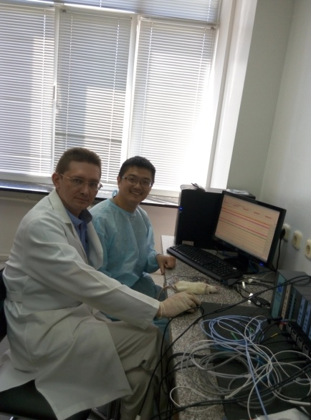
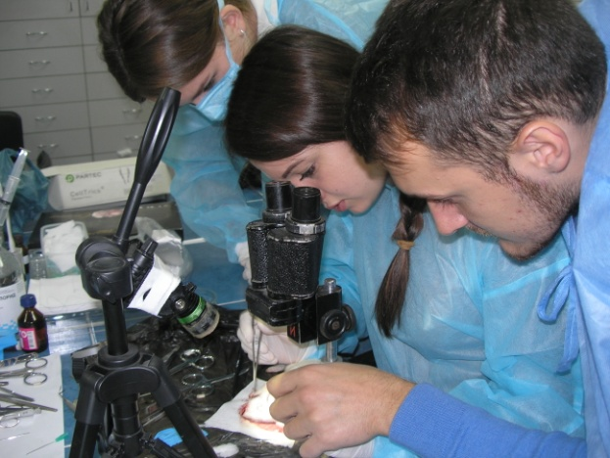
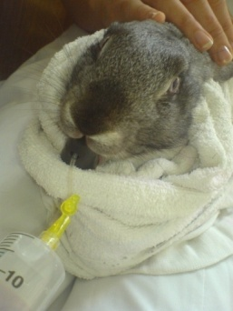
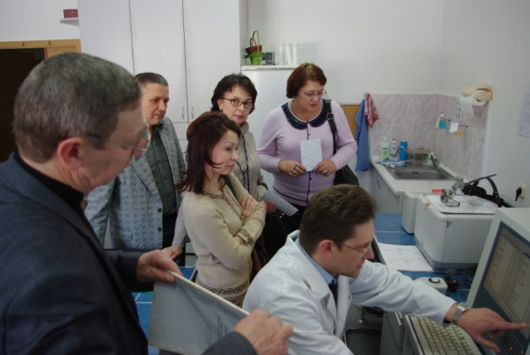
Familiarity with research work on modern preclinical study of ophthalmic pharmacological agents, both by foreign scientists and with their own research staff of the Department of Ophthalmology.

Slide 5

And more!
Successful completion
discipline
"Pharmacotherapy in ophthalmology"
will provide advantages when enrolling in an internship in the specialty "Ophthalmology".

Slide 6
The purpose of the educational program
Master the rules and principles of prescribing ophthalmic drugs, taking into account the patient's comorbidities
Assimilate a variety of local and systemic complications of ophthalmic drugs, get acquainted with the pathophysiological mechanisms of their development.
To study the influence of ophthalmic and other pharmacological agents on the visual analyzer and the body as a whole, the principles of rational therapy of various pathologies of the organ of vision and its accessory structures.
The program is aimed at forming an effective, high-quality, modern educational system and is designed to ensure the competitiveness of students in general in the market of services in educational, scientific, innovative and professional activities.

Slide 7
Learning objectives
To form and improve the professional training of a doctor who has clinical thinking, is well versed in complex pathology, has in-depth knowledge of related disciplines.
To prepare a specialist for independent professional medical and diagnostic activities, able to conduct a differential diagnostic search, provide full medical care, including in emergencies, to carry out preventive and rehabilitation measures in patients with ophthalmic pathology at all ages.
To prepare a doctor who has the skills and medical manipulations in accordance with the qualification requirements and general medical manipulations to provide emergency care in ophthalmology.
To form abilities and skills of independent research activity, possibilities of communication with professional medical ophthalmological associations and organizations.

Slide 8
Contents of the materials of the program "Pharmacotherapy in ophthalmology"
Modern pharmacological treatment of various pathologies of the visual analyzer;
Minimization of probability and avoidance of medical errors at application of ophthalmic and other pharmaceuticals;
Optimization of the patient's financial costs for ophthalmic treatment;
Ability to scientifically substantiate the appointment of a particular ophthalmic drug;
Mastering the skills of adequate search and analysis of medical information on the use of pharmacological agents in the treatment of ophthalmopathology of various origins;
Get acquainted with the preclinical study of pharmacological agents in ophthalmology;
Evaluation of the effectiveness of pharmacological agents in ophthalmology from the standpoint of evidence-based medicine;
Legal aspects of the use of pharmacological agents in the treatment of eye diseases and its applications;
Study of the compatibility of pharmacological agents used in the treatment of ophthalmopathology
Study of the interaction of ophthalmic pharmaceuticals and food, etc ..
Methods of introduction of ophthalmic drugs into the human body;
Study of the peculiarities of application and dosage of ophthalmic drugs for adults and children.

Slide 9
Multidisciplinary approach in the discipline
"Pharmacotherapy in ophthalmology"
According to the curriculum, the discipline "Pharmacotherapy in Ophthalmology" uses, complements and expands the study of many other, both theoretical and practical disciplines:
histology
pathological anatomy
normal physiology
pathological physiology
biochemistry
molecular biology
microbiology
pharmacology
internal diseases
infectious diseases
immunology
gynecology, etc.

Slide 10
List of practical skills
Level of skill development:
1 - to have an idea, to be professionally oriented, to know impressions for purpose
2 - to know, evaluate, participate
3 - do it yourself

Slide 11


WAITING FOR YOU!
Where else can we be found?
Department of Ophthalmology VNMU
votcup.com

